Slide 1

MADAN MOHAN MALAVIYA UNIVERSITY OF TECHNOLOGY
GORAKHPUR - 273016
“MUSIC PLAYER”
To the Madan Mohan Malaviya University of Technology during the academic year 2022-2023 in partial fulfillment for the award of
MASTER OF COMPUTER APPLICATION
Submitted by:
Name: Roll No.:
ANAND CHAUHAN [2021104011]
Under the Guidance of,
Prof. R.K. Dwivedi,
Assistant Professor,
Department of Information Technology & Computer Application,
Madan Mohan Malaviya University of Technology, Gorakhpur
DEPARTMENT OF INFORMATION TECHNOLOGY &
COMPUTER APPLICATION

Slide 2
ABSTRACT
Audio is an important source of communication and is just as important today as text. We know that audio files are digital files. So you need a tool to run the digital files, or in other words to play the files. Without this tool or player, we can never listen to music, movies or the contents of an audio file. So we need music players. This device is used to play music and other digital audio files. You can do it yourself, without having to download and install premium music players. The music player GUI project idea tries to emulate the physical music player. This program allows you to play songs, music and all music files on your desktop or laptop. Using Python is a basic programming application built using the Python programming language. It is a GUI program created using the Python Tkinter pygame libraries. The music player application must be able to play a song, create and display a playlist, pause and resume a long song, and change the song. play the previous or next song.
Keywords: Music, Python, GUI, MP3

Slide 3
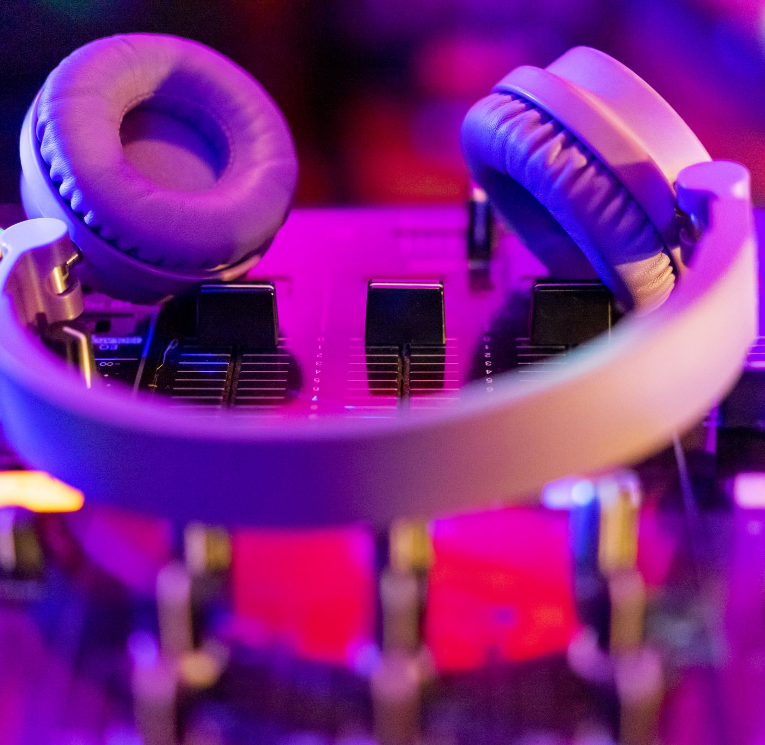
MUSIC PLAYER

Slide 4
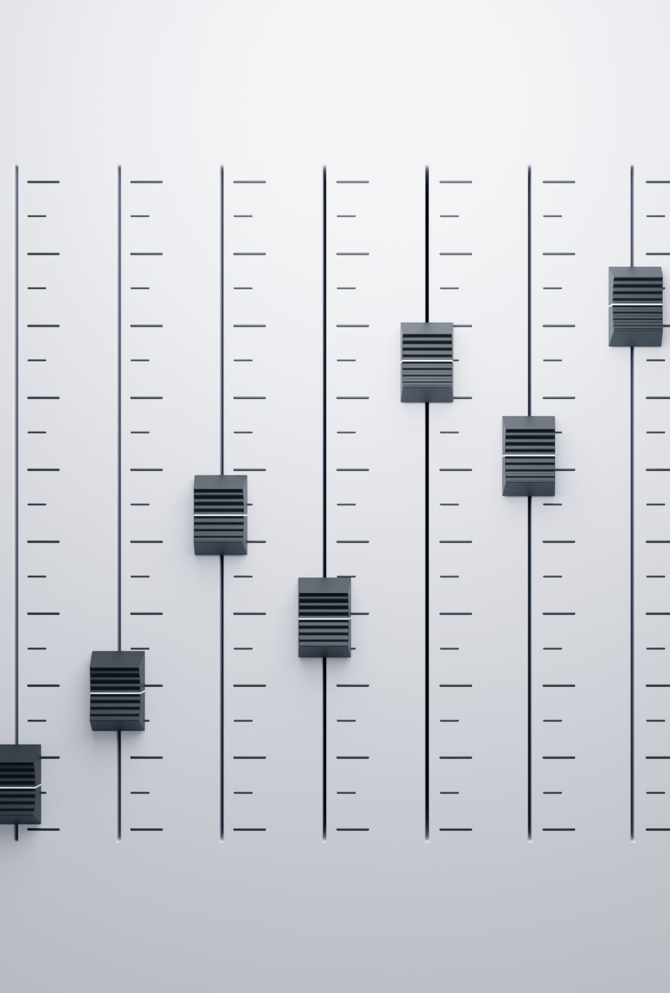
Music Player in Python Introduction:
We need an application that will allow us to play or listen to digital audio files. The music player is the device for playing MP3 and other digital audio files. The music GUI program application attempts to emulate the physical music player. This program allows you to play songs, music and all music files on your desktop or laptop. The main goal of this project is to enable users to play music and digital audio files. In order to be attractive to users, the application must have a simple but beautiful user interface. Music Player has options to play, pause and stop. We can have an interface to list the music files available. You can also allow users to list other digital audio files that are not music. Users are also waiting for the music player. have an interface that displays information about the file being played. Python has libraries that can play audio files, such as: B. Pygame, which allows you to work with media files in just a few lines of code. Recently, music has become popular with this generation. Most software companies develop so many types of players that they can support MP3 files. We can also implement a feature that allows users to create a playlist.

Slide 5
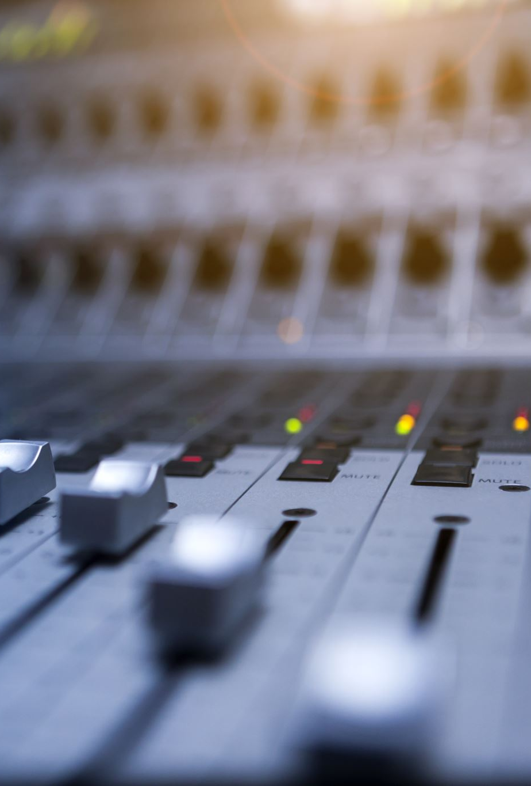
PROBLEM DESCRIPTION
To create an MP3 player using the Python programming language to play and listen to songs, MP3 files, and other digital audio files. The player must have a simple and easy-to-use interface with options for various functions and a screen around the entire playlist and buttons to turn off the player. The player should be able to play any song. It must be able to play MP3 files or other digital audio files. It should give the user the option to pause or resume the song. the user should be given basic details about the song being played.

Slide 6
ALGORITHM
1.Import the libraries.
2. Create an object of the tkinter and Pygame libraries.
3. Create a window using Tkinter object.
4. Add buttons that provide different functionalities.
• Play the song
• Pause the song
• Play previous song
• Play next song

Slide 7
PYTHON LIBRARIES USED
Tkinter: We already told you in the title of this page that we will be using the Tkinter library, a standard library for GUI creation. The Tkinter library is the most popular and easiest to use and contains many widgets (these widgets help create attractive GUI applications). Also, Tkinter is a very lightweight module and useful for building cross-platform applications (so the same code can be easily used on Windows, macOS, and Linux.)
b. Pygame module: Pygame is a Python module that works with computer graphics and sound libraries and designed with the power of playing with different multimedia formats like audio, video, etc.
c. OS module: There is no need to explicitly install this module as it comes with the standard Python library. This module offers various functions for interacting with the operating system. In this tutorial we will use the OS module to get the song playlist. from the specified directory and make it available to the music player application.

Slide 8
SYSTEM SPECIFICATION
Software Requirements:
• Language used: Python
• IDE: IDLE(Python3.11 64-bit)
Hardware Components:
• Processor – i5
• Hard Disk – 221 GB
• Memory – 8 GB RAM
• Operating System – Windows 10

Slide 9
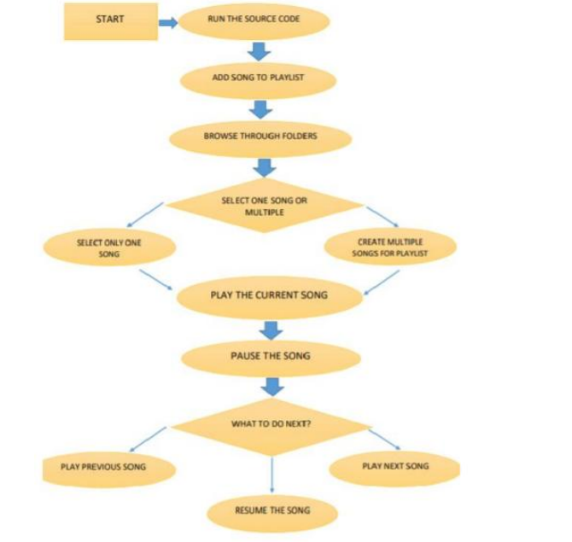
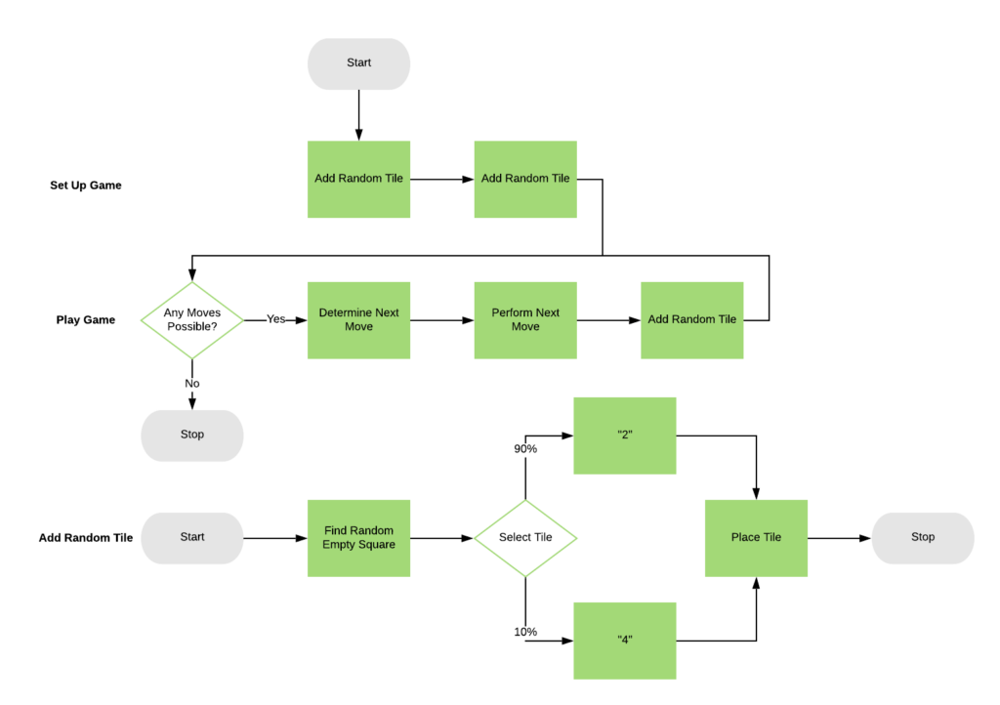
DATA FLOW DIAGRAM

Slide 10
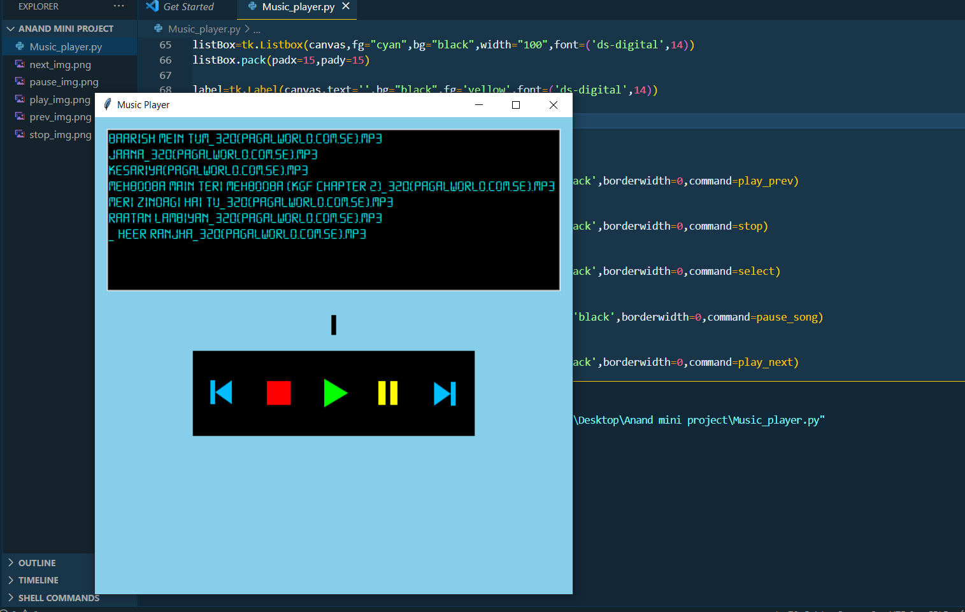
OUTPUT OF MUSIC PLAYER

Slide 13
Thank You!

